Slide 1

Fingerprint recognition
Name: Wen Liu C00105088
Supervisor: Nigel Whyte
Institute of Technology, Carlow 2010
Notes:
Good afternoon everyone, Today I will introduce my project –FR system to you and my supervisor is Mr. Nigel Whyte

Slide 2
Aim of this project
To build up a fingerprint recognition application which take two enrolled images and output the matching result.
A acceptable processing time and accuracy.
Easy to use, GUI friendliness.
Notes:
Firstly, the aim of this project is to produce a FR software which take two images selected from database
Verify a match between them and output the result.
The product should contain acceptable processing time and accuracy.
It also should has an nice and friendly GUI and doesn’t contains redundant functions and components

Slide 3
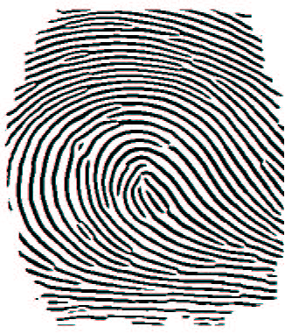
Principles of Fingerprint
Made up of ridges and valleys.
Individual epidermal ridges and valleys have different characteristics for different fingerprints.
Experience shows that no two individuals have fingers exactly alike.
Notes:
I don’t think anyone will ask me what fp is. technically Fingerprints are made up of ridges and valleys
(look figure)

Slide 4
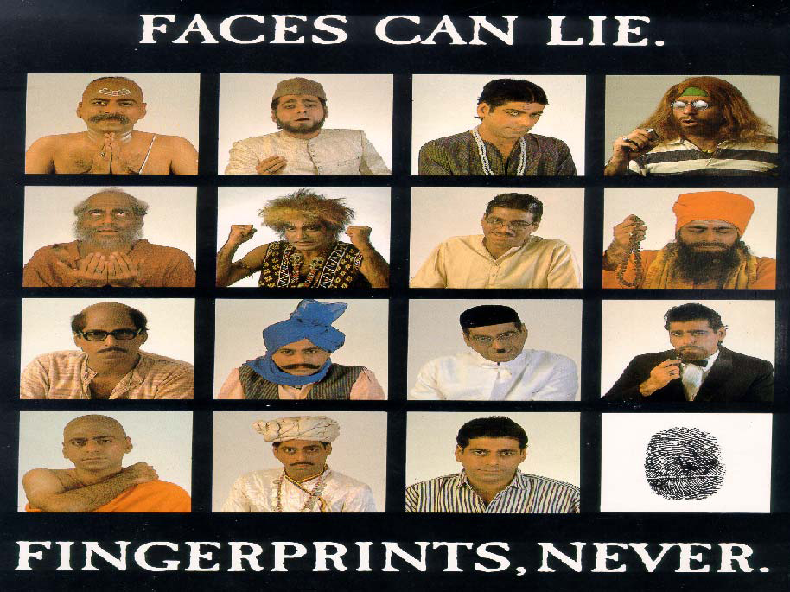
Fingerprint never lie…
Notes:
And that’s why we said fingerprint never lie. People can easily change their faces or imitate a hand writing.
But the Fp are extremely hard to fake.

Slide 5
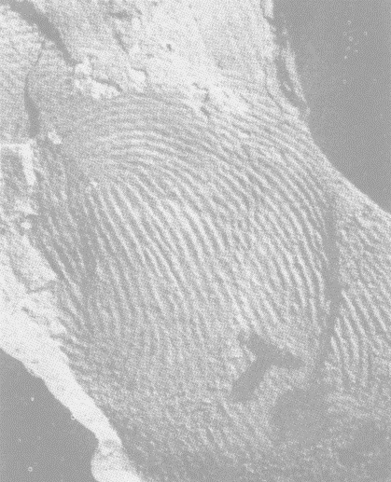
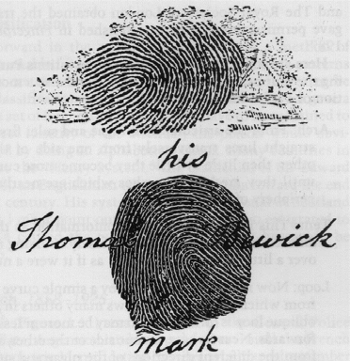
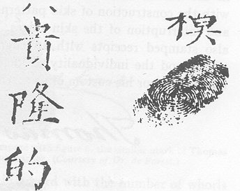
History of fingerprints
Fingerprint on Palestinian lamp (400 A.D.)
Berwick's trademark (1809)
A Chinese deed of sale (1839) signed with a fingerprint
Notes:
Fingerprint has been used to certify an identity since antiquity, and you find them on many antique

Slide 6
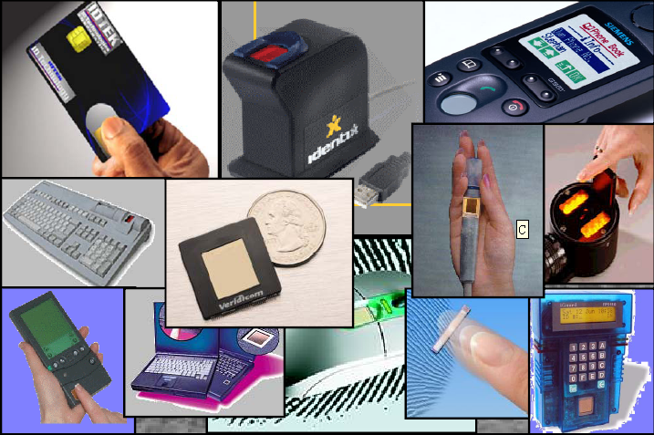
Fingerprint technique nowadays
Notes:
Nowadays, FR technique can be found in many different areas such as justice, finance, security, communication and so on. It is the most widely used biometric technique.

Slide 7
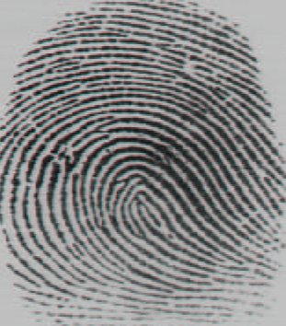


Technique background
Pre-processing
Post-processing
Input Image
Enhanced Image
Thinned Image
Minutiae extracted
Fingerprint Matching
Notes:
About the FR technique, there are two main components: preprocessing and post processing.
In preprocessing a input image will be enhanced firstly and then be thinned,
In the post processing, the minutiae will be extracted from thinned image, minutiae are major features of a fingerprint. they are used to match a pair of fingerprints

Slide 8
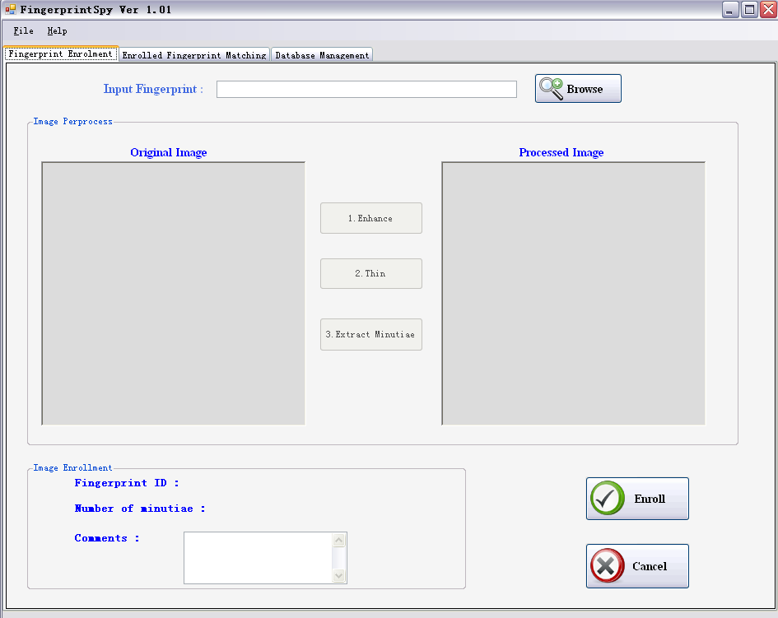
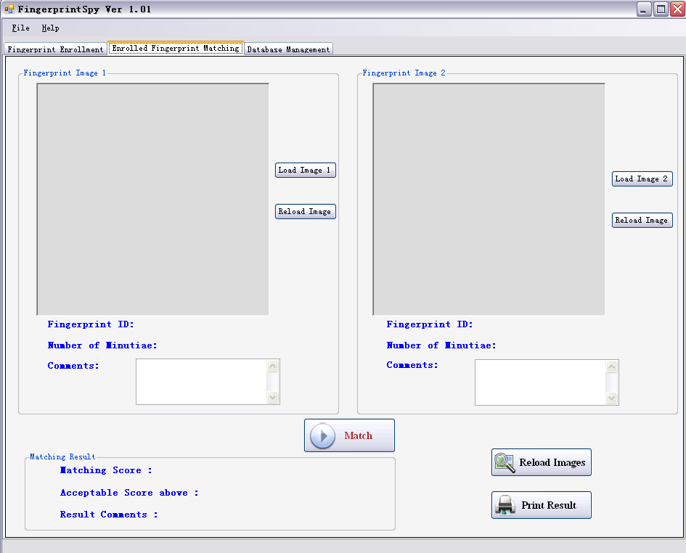
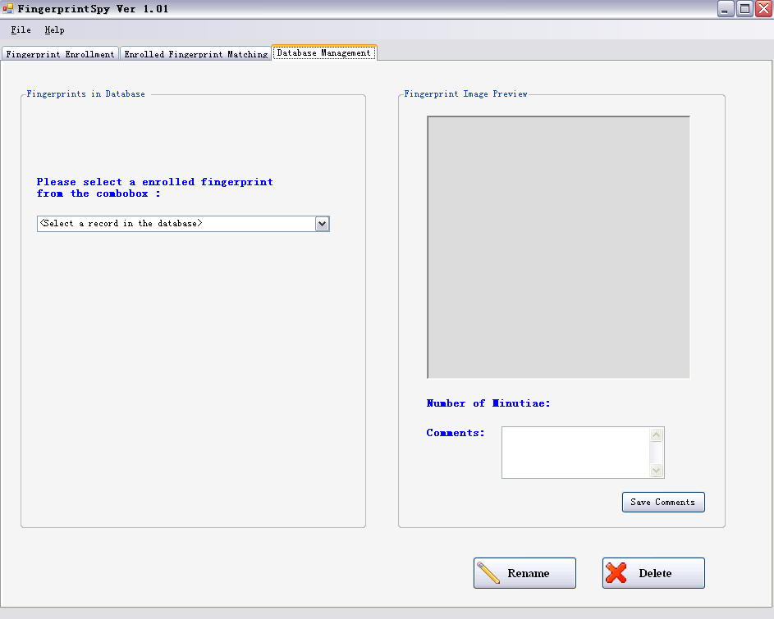
What I have done so far.
GUI
Section 2:Fingerprint Matching
Section 3:Database Management
Section 1: Fingerprint Enrollment
Notes:
The first part I have done is the GUI of the software. The GUI has 3 different functional section
………
As you can see from the screenshots the layout of the GUI is pretty straightforward.

Slide 9
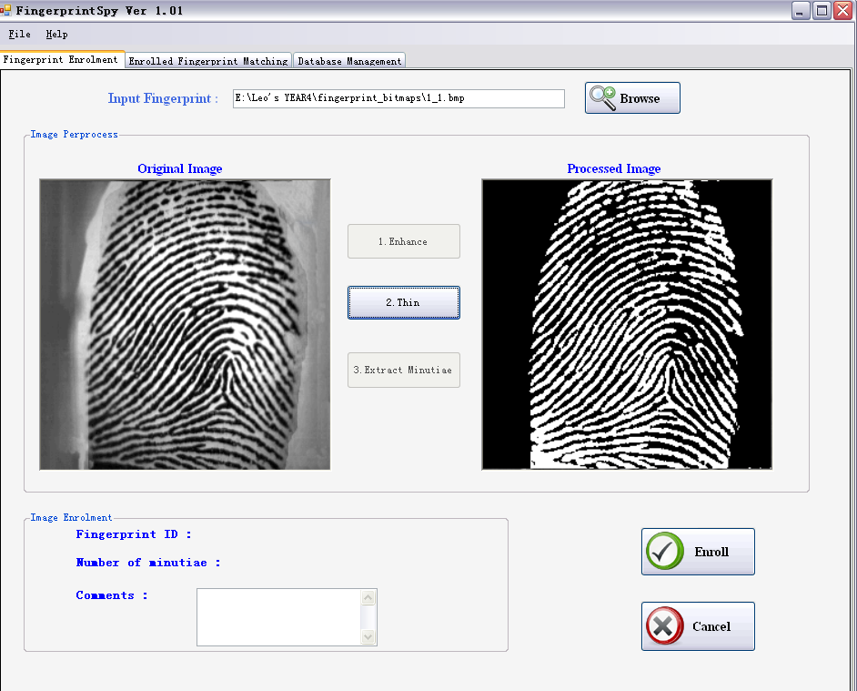

What I have done so far..
Image enhancement
Guass Smooth
Binarization
If Avg >= 100
iPixel = 0
else
iPixel = 255
setPixel(iPixel,iPixel,iPixel)
Notes:
The first step of image pre processing – image enhancement is done.
I use guass operator to smooth the image first and then do the binarization. I set 100 as a threshold,
If red in RGB is great than 100 means write then…… or then……

Slide 10
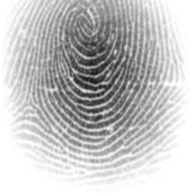
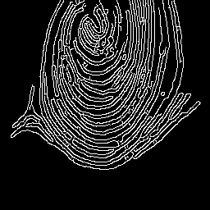
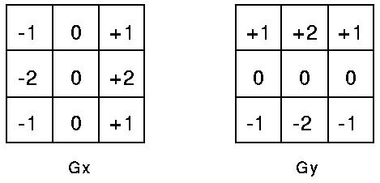
What I have done so far..
Problems I met in image enhancement
Sobel operators
|G | = |Gx| +|Gy|
Hollow ridge lines, impossible to thin.
Notes:
In my research report I mentioned that I’d like to use Sobel edge detection technique to ……
But the output are circles with 1 pixel width. that’s impossible to get thinned ridge lines in the next stop. That is the reason why I changed my enhancement algorithm to Guass smooth and binarization

Slide 11
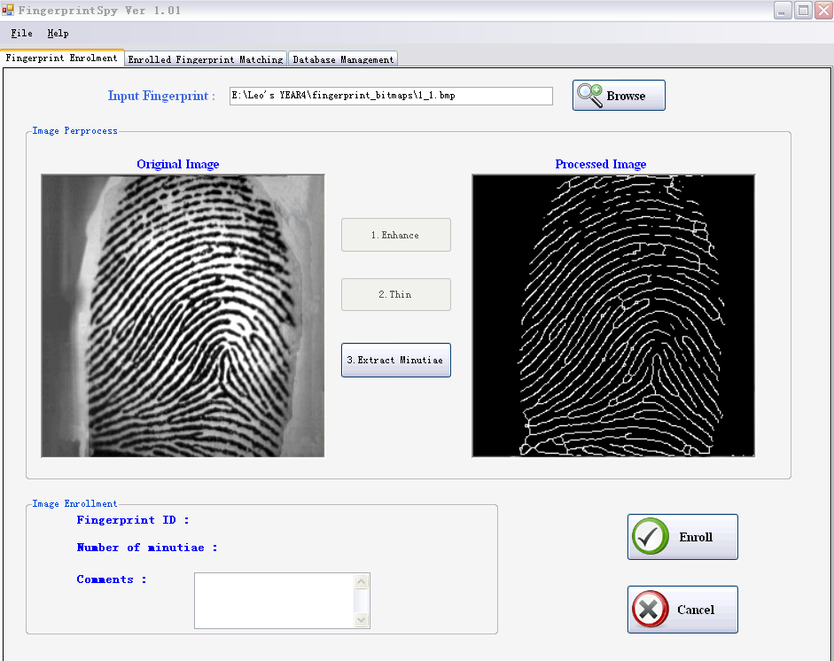
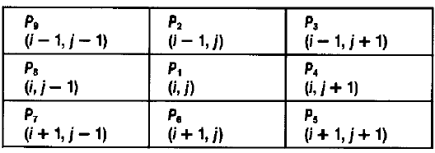
What I have done so far…
Image thinning
Zhang-suen Thinning
2 <= B(P1) <= 6
(b) A(P1) = 1
(c) P2*P4*P6 = 0
(d) P4*P6*P8 = 0
(c') P2*P4*P8 = 0
(d') P2*P6*P8 = 0
Notes:
The image thinning process is also done.. Zhang suen thinning technique.. 3X3 matrix

Slide 12
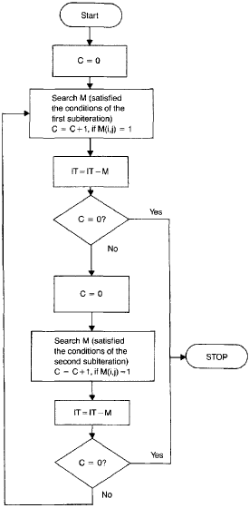



What I have done so far…
Problems I met in image thinning
Misunderstood with processing sequence causes coding nightmare.
Problem fixed.
Processing time – before : 10 – 12 seconds
    after: 5 seconds
Notes:
There are several different version of this technique, and I misunderstood with ……
As the consequence I got a weird result.
simplify

Slide 13
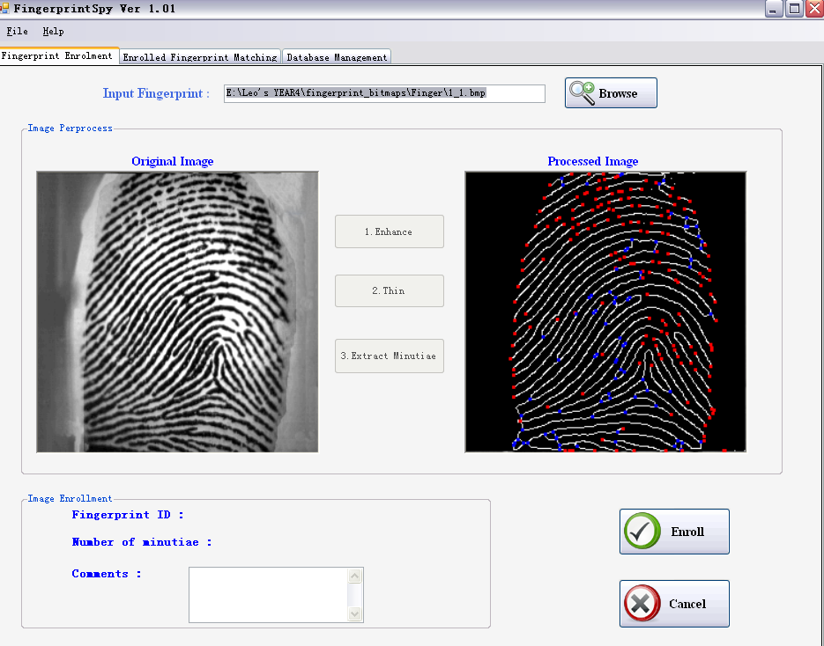

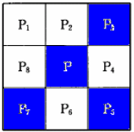
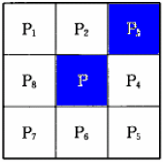
What I have done so far……
Minutiae Extraction
Rutovitz’s definition
Cn(P) = 3 Cn(P) =1
Bifurcation End

Slide 14






What I have done so far……
Problems I met in minutiae extraction
Fake minutiae elimination
More than half of the minutiae are fakes.
spike
bridge
hole
Keep the number of minutiae in a range of 30~40 per fingerprint
break
ladder
spur

Slide 15
What I have done so far……
Nearly 40% of the project is completed.
A little bit behind the schedule.
I’m happy with what I have done so far. ☺

Slide 16
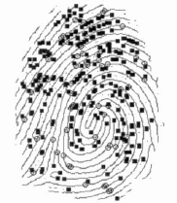
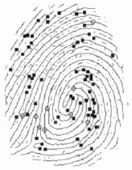
The work I still have to do
Fake minutiae elimination.
Image enrollment.
  Two databases
Matching.
  Using core point based local matching technique.
Database Management.
  Being able to modify information of enrolled images

Slide 17
Technology Discussion
Platform : Windows XP
Language: Visual C#
  Support GDI+
IDE: Microsoft Visual Studio 2008
  Easy to set up application GUI.
No SDK used
  Fingerprint scanner is dead.

Slide 18
Potential Issues & Challenges
Complexity of matching algorithm.
The system accuracy.
I am confident that I will finish it on time.

Slide 19
Any Questions ?
Thanks for listening!

